Slide 1

Contributing and editing the GND Authority Records to external system which upon approval copies them to the Alma community zone
Yoel Kortick
Senior Librarian

Slide 2
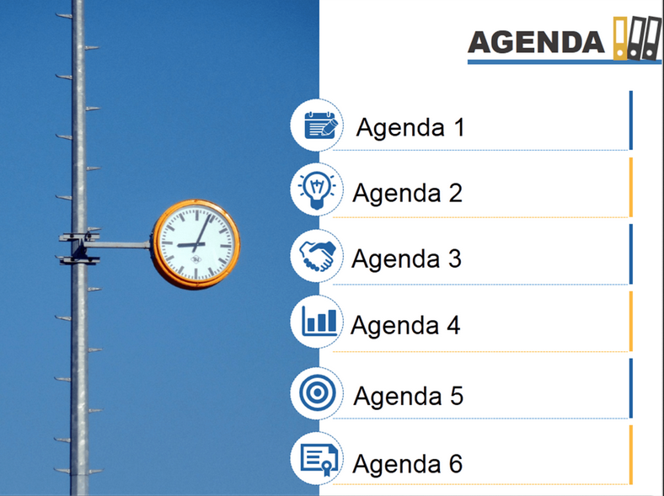
Agenda
Introduction
CZ definitions
IZ definitions
Edit existing record
Contribute new record
Summary

Slide 3
Introduction
This presentation will discuss how institutions can
Contribute GND authority records to an external system which upon approval copies them to the Alma community zone
Edit existing GND authority records in the Alma community zone
For the remainder of this document:
We will use "CZ" abbreviation for "Community Zone"
When we state "contribute" we also mean both "contribute new" and "edit existing"

Slide 4
Introduction
We will not be discussing the use of the GND authority records in the institution’s repository.
For information about the use of the GND authority records in the institution’s repository see: https://knowledge.exlibrisgroup.com/Alma/Product_Documentation/Alma_Online_Help_(English)/Resource_Management/040Metadata_Management/060Working_with_Authority_Records#GND_Bibliographic_Control_Fields_Used_with_F3

Slide 5
Agenda
Introduction
CZ definitions
IZ definitions
Edit existing record
Contribute new record
Summary

Slide 6
Prerequisite CZ definitions
Not every institution in the world is allowed contribute records to an external system which later upon approval copies them to the Community Zone.
This is a functionality allowed by Ex Libris and dependent on relevant configurations done by Ex Libris in the CZ.
While the configuration is done by Ex Libris in the CZ, we feel in any case that it would be useful to show the configuration here, as this will contribute to the overall understanding of the process.

Slide 7
Prerequisite CZ definitions
In the CZ there is an integration profile which is:
Integration Type: Authority Record Contribution
Name: GND
Code: GND

Slide 8
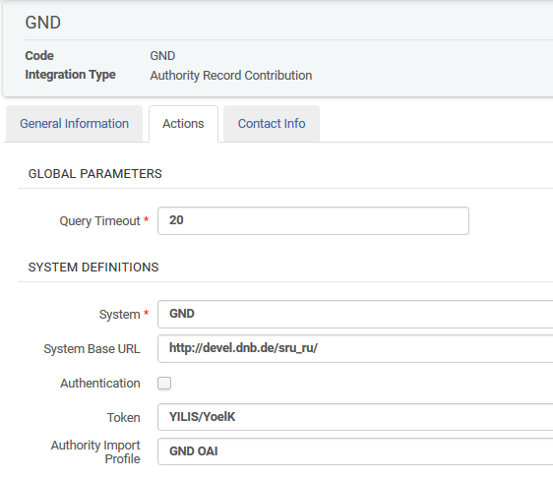
Prerequisite CZ definitions
Sample GND Integration profile in the CZ

Slide 9
Prerequisite CZ definitions
In the CZ cataloging configuration there is a list of "Allowed Contribution Authorized Institutions".
This list includes the codes of the institutions which can contribute to the CZ.
Only these institutions can contribute.

Slide 10
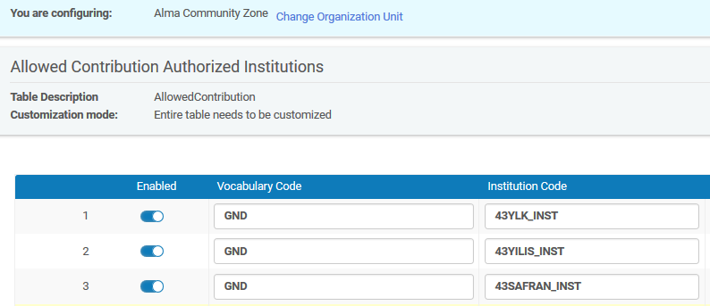
Prerequisite CZ definitions
Sample list of institutions

Slide 11
Agenda
Introduction
CZ definitions
IZ definitions
Edit existing record
Contribute new record
Summary

Slide 12
Prerequisite IZ definitions
In the institution zone the parameter "is_institution_cz_contributor" must be set to true.
Again, this is a definition set by Ex Libris but we are showing it here in any case to add to the overall understanding of the process.
Only institutions with this set to true can contribute authority records to the CZ.

Slide 13
Prerequisite IZ definitions
In the institution zone the parameter "GND_token" must be filled in.
This is located under Configuration > Resources > Other Settings
Only institutions with a valid token here can contribute authority records to the CZ.

Slide 14
Prerequisite IZ definitions
In the institution zone the "Cataloging Level Mapping for External Authority" must be defined.
This is located under "Configuration > Resources > Cataloging"
This table maps the Alma cataloger levels to the cataloger levels defined in the external system.
If the cataloging level of the cataloger in the IZ is lower than what is defined in this table then the cataloger will not be able to contribute and will get an appropriate message stating this when contributing a CZ record

Slide 15
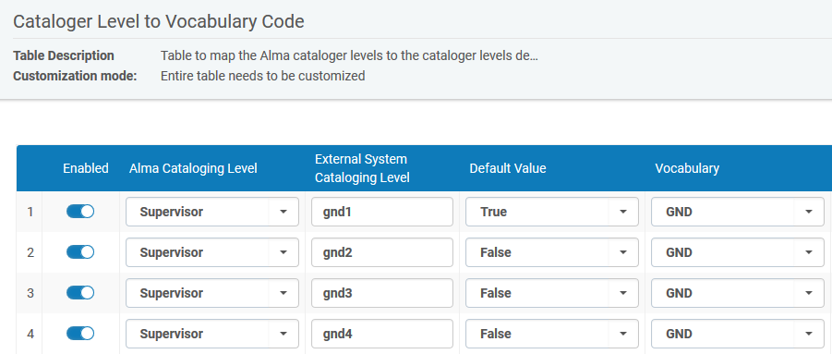
Prerequisite IZ definitions
Cataloging Level Mapping for External Authority

Slide 16
Agenda
Introduction
CZ definitions
IZ definitions
Edit existing record
Contribute new record
Summary

Slide 17
Editing existing CZ GND authority
To edit an existing CZ GND authority record:
Search the CZ for the authority record
Find it
Click "edit record"
It opens in metadata editor
Edit as desired
Save
Note that when saving a GND authority the system sends the request to the GND. Only upon successful update of the authority record in the GND is the authority saved in the CZ.

Slide 18
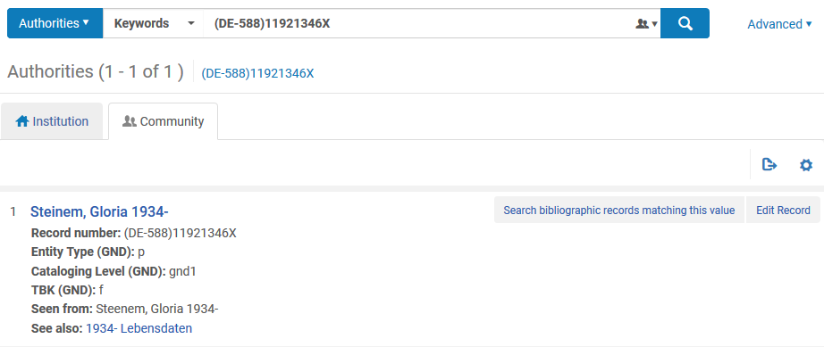
Editing existing CZ GND authority
Here we have searched the CZ for authority (DE-588)11921346X and found the following GND record for "Steinem, Gloria 1934-"
Now we will click "Edit Record"

Slide 19
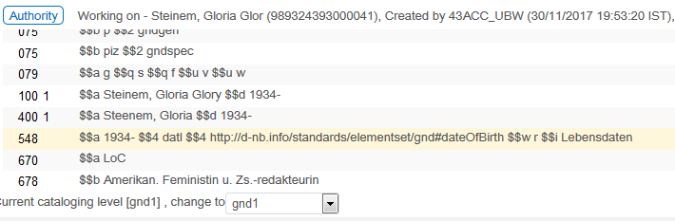
Editing existing CZ GND authority
The record opens in the metadata editor
We change the 100 field from
$$a Steinem, Gloria $$d 1934-
to
$$a Steinem, Gloria Glory $$d 1934-

Slide 20
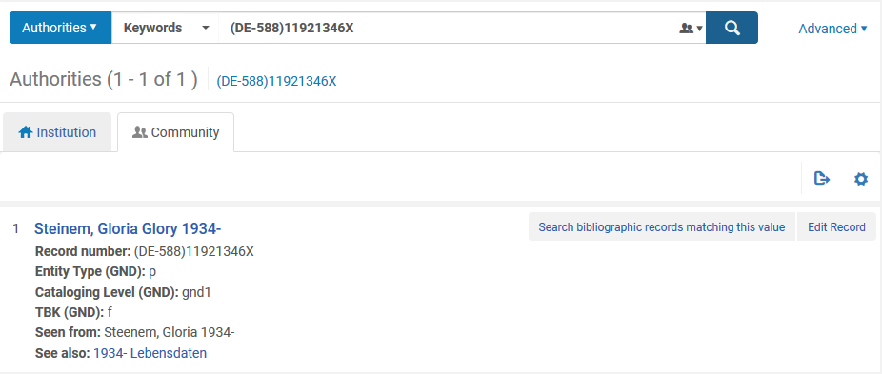
Editing existing CZ GND authority
Now if we again search the CZ for authority (DE-588)11921346X we see that the record in the CZ has changed
New version of the record is immediately in the CZ

Slide 21
Agenda
Introduction
CZ definitions
IZ definitions
Edit existing record
Contribute new record
Summary

Slide 22
Contributing a new CZ GND authority
To contribute a new CZ GND authority
Open the metadata editor in your institution
Either
  Create a new record via:
  File > New > German National Library Names and Subject Headings
  Duplicate existing CZ authority via:
  Open it in metadata editor and click "File > Duplicate"
Catalog record as desired and save

Slide 23
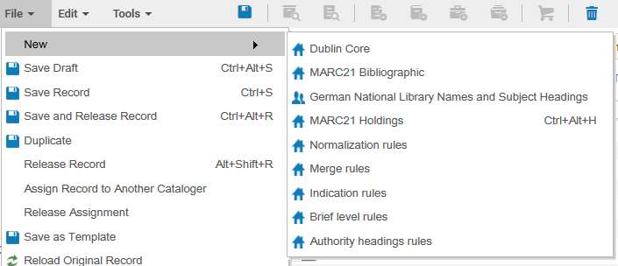
Contributing a new CZ GND authority

Slide 24
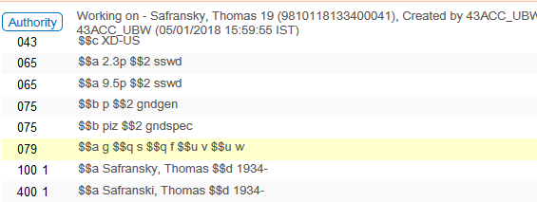
Contributing a new CZ GND authority
Here we have catalogued a GND authority record with
  Preferred term "Safransky, Thomas"
  Non-preferred term "Safranski, Thomas"

Slide 25
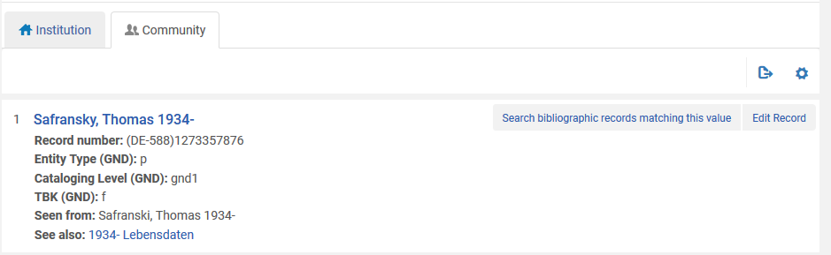
Contributing a new CZ GND authority
If we search the CZ we see that he has been successfully contributed as a GND authority.

Slide 26
Agenda
Introduction
CZ definitions
IZ definitions
Edit existing record
Contribute new record
Summary

Slide 27
Summary
If an institution is defined as a GND contributor by Ex Libris then it may
  Contribute new GND authority records to an external system which upon approval by that system will copy it to the CZ
  Edit existing GND authority records in the CZ

Slide 28
Summary
New records are contributed by the institution by either
  Cataloging a new record and saving
  Duplicating an existing record and saving
Existing records are edited by
  Finding the record in the CZ
  Clicking 'Edit record"
  Editing and saving the record

Slide 29
Summary
Each institution can control who can edit these records by using the cataloging level feature
When the authority record is contributed or edited it is immediately available for all other institutions to see and use.

Slide 30


THANK YOU

